Slide 1

CSS
Lesson 2

Slide 2
CSS Text
Property | Description
color | Sets the color of text
direction | Specifies the text direction/writing direction
letter-spacing | Increases or decreases the space between characters in a text
line-height | Sets the line height
text-align | Specifies the horizontal alignment of text
text-decoration | Specifies the decoration added to text
text-indent | Specifies the indentation of the first line in a text-block
text-shadow | Specifies the shadow effect added to text
text-transform | Controls the capitalization of text
word-spacing | Increases or decreases the space between words in a text

Slide 3
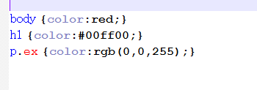
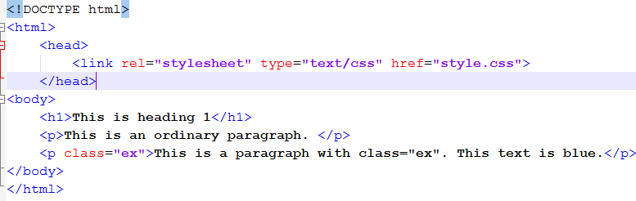
CSS Text
Color
The color property specifies the color of text.
style.css
doc.html

Slide 4

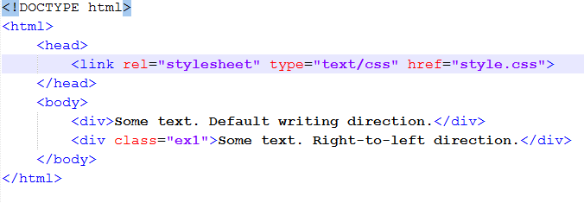
CSS Text
Direction
style.css
Default value: | ltr
The direction property specifies the text direction/writing direction.
doc.html

Slide 5

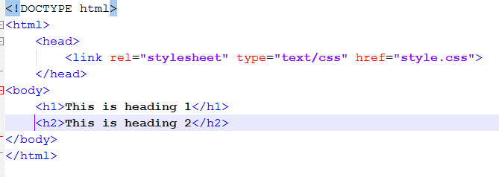
CSS Text
Letter-spacing
style.css
The letter-spacing property increases or decreases the space between characters in a text.
doc.html

Slide 6

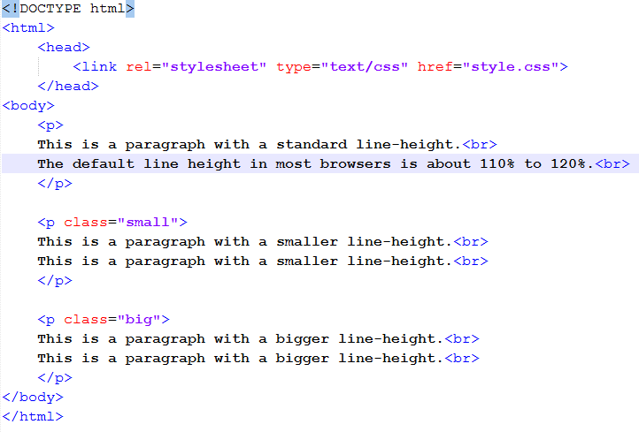
CSS Text
The line-height property specifies the line height.
Line-height
style.css
doc.html
number
length
%

Slide 7

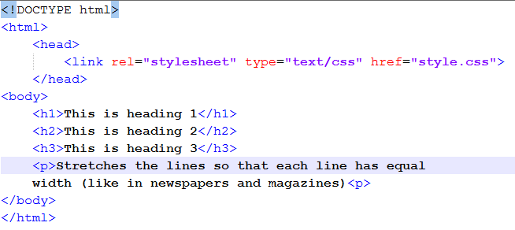
CSS Text
The text-align property specifies the horizontal alignment of text in an element.
Text-align
style.css
doc.html

Slide 8

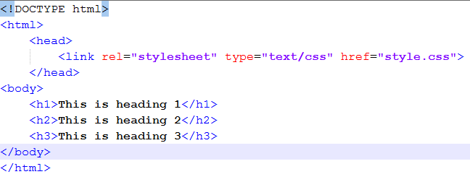
CSS Text
The text-decoration property specifies the decoration added to text.
Text-decoration
style.css
doc.html

Slide 9

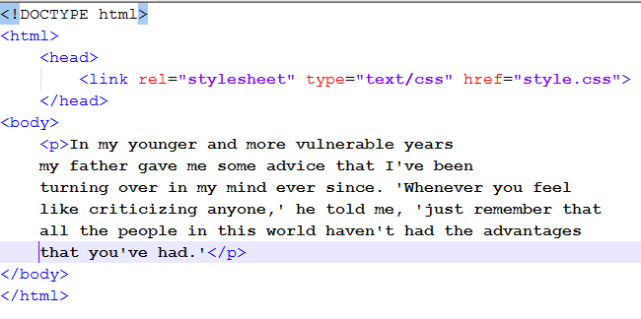
CSS Text
Text-indent
The text-indent property specifies the indentation of the first line in a text-block.
style.css
doc.html

Slide 10

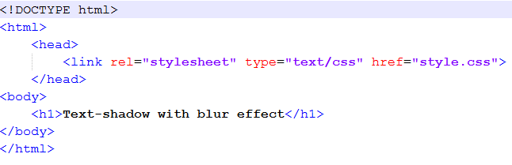

CSS Text
Text-shadow
The text-shadow property attaches one or more shadows to text.
style.css
doc.html

Slide 11

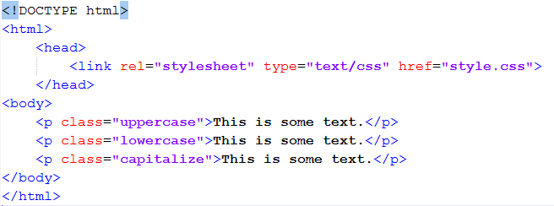
CSS Text
Text-transform
The text-transform property controls the capitalization of text.
style.css
doc.html

Slide 12

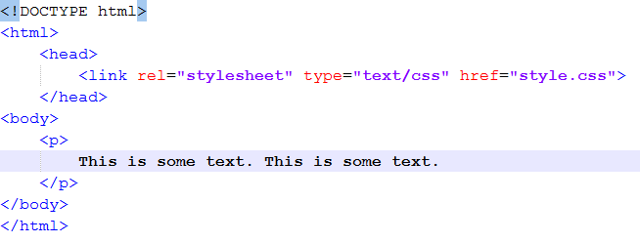
CSS Text
Word-spacing
The word-spacing property increases or decreases the white space between words.
style.css
doc.html

Slide 13

Task1:

